Slide 1





Mandheling: Mixed-Precision On-Device DNN Training with DSP Offloading
Linggui Tech
Company
Daliang Xu^{1*}, Mengwei Xu^{2*}, Qipeng Wang¹, Shangguang Wang², Yun Ma¹, Kang Huang³, Gang Huang¹, Xin Jin¹, Xuanzhe Liu¹
^{(*co-primary)}
¹Key Lab of High Confidence Software Technologies (Peking University)
²State Key Laboratory of Networking and Switching Technology (BUPT)
³Linggui Tech Company
Notes:
Hello, everyone. I’m Daliang Xu from Peking University. Today, I will share with you our recent work: Mandheling: Mixed-Precision On-Device DNN Training with DSP Offloading

Slide 2
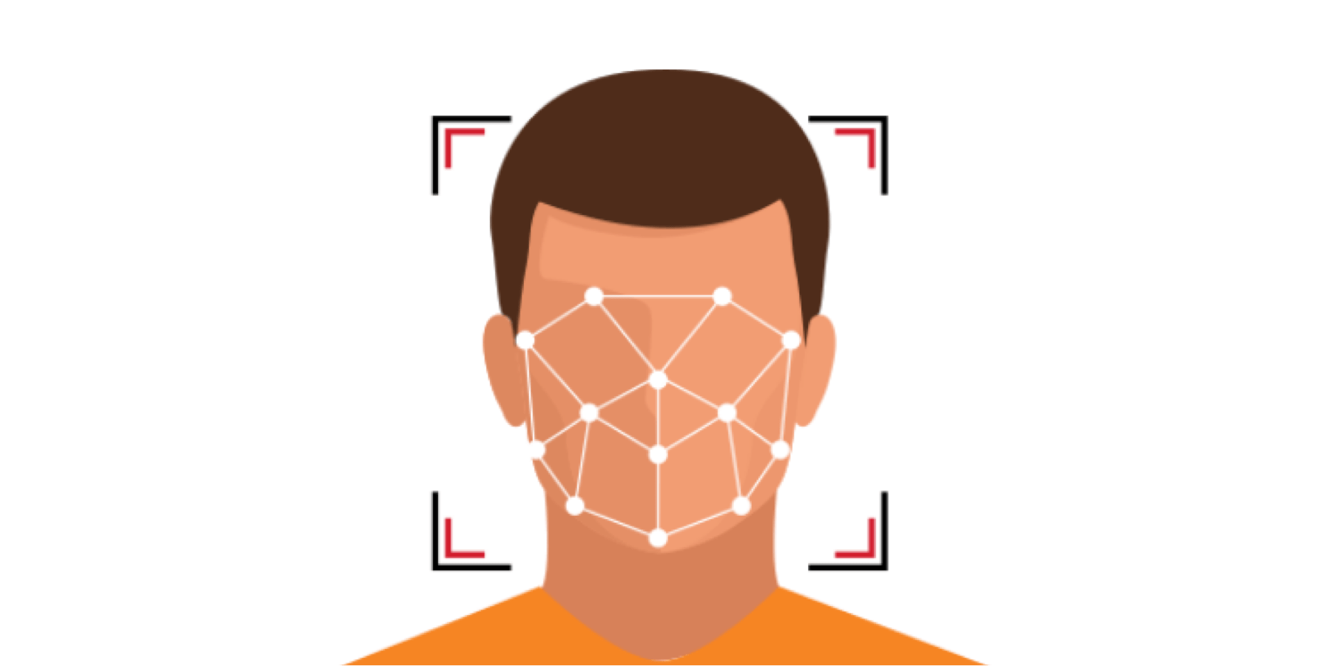

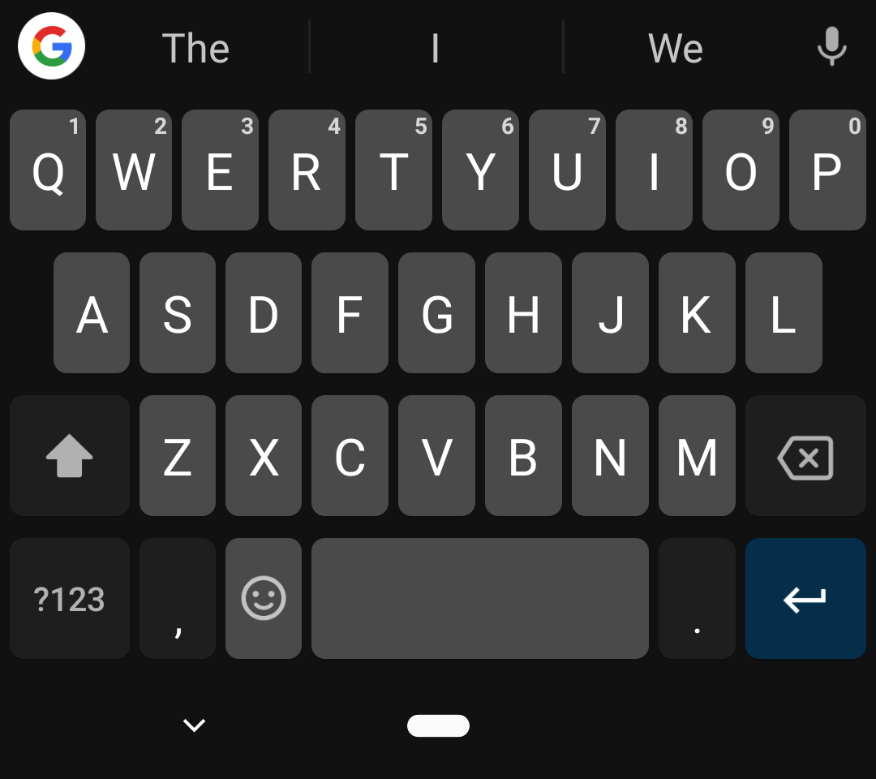

Emerging mobile DNN applications
Face detection
Voice recognition
Input method editor
Augmented Reality
Mainly DNN inference now
Notes:
Nowadays, Deep neural network has been a key component of today’s mobile application, like face detection and voice recognition.
(click)
However, these apps mainly run DNN inference now.

Slide 3
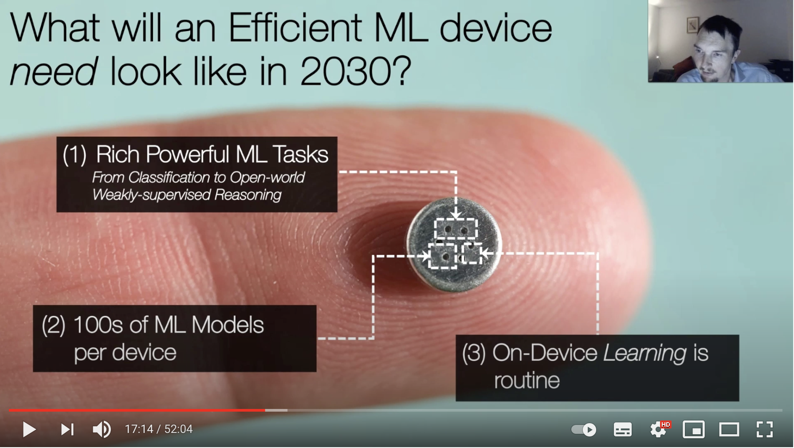


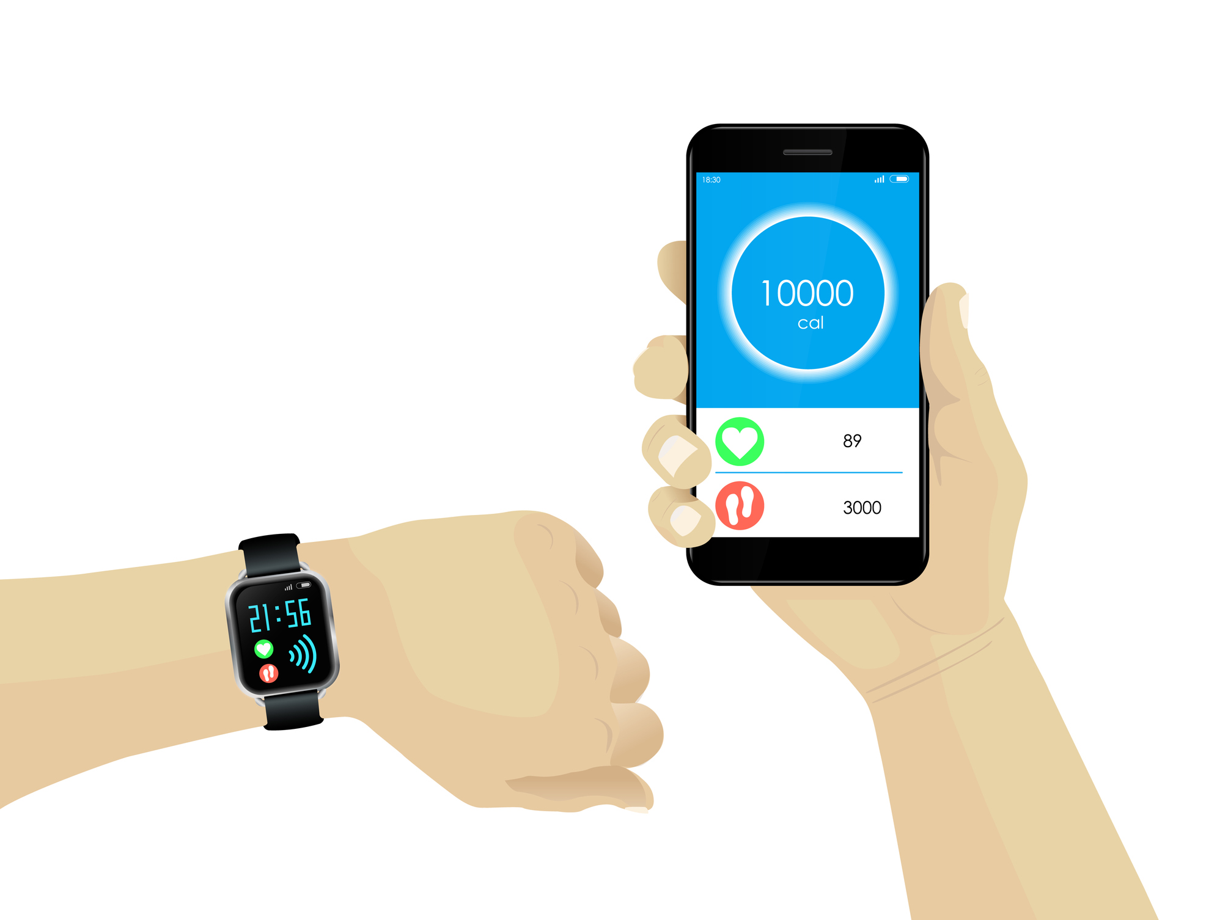






Emerging on-device learning
Privacy concerns
MobiCom 2020 - Rock Star Award - What is Next for the Efficient Machine Learning Revolution?
On-device training paradigm
Server
Notes:
With ever-increasing data privacy concerns, such as GDPR, empowering a mobile device to train a deep DNN locally (i.e.,(that is) on-device training) has recently attracted attention from both academia and industry
(click1)
(click2)
traditional approach collects user's data to cloud server, and trains global model based on the whole dataset. But it may cause privacy concerns.
(click3)
As a forward step, researchers have proposed on-device learning, which trains the model on user’s device with only the data stored on the device, without uploading the data to cloud server. Such approach avoids private data leaking.
(click4)
Moreover, on-device learning has been a key enabler of emerging learning paradigms, like federated learning. Google Gboard and Apple SIRI use such paradigm to train models.

Slide 4
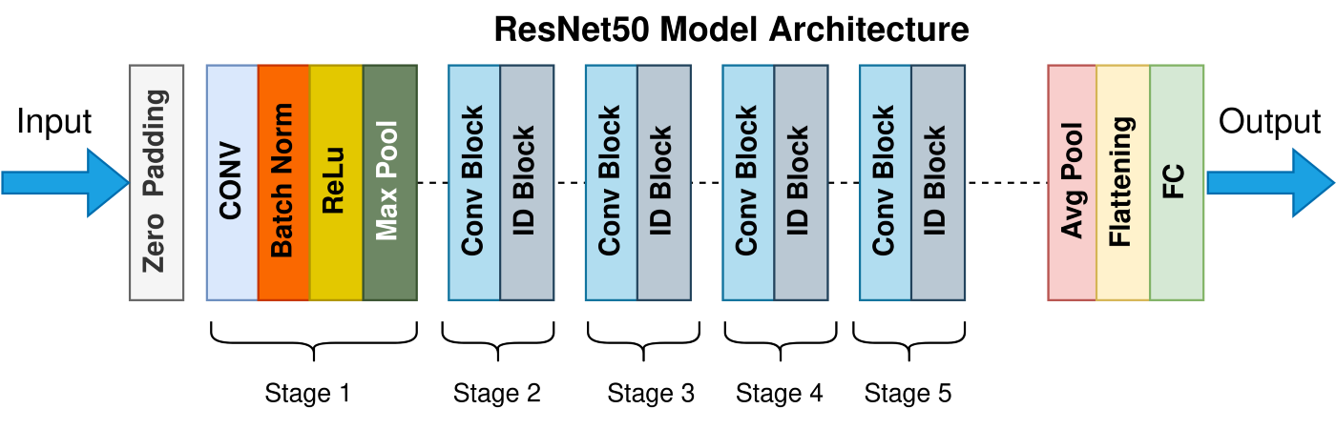


On-device training incurs huge resource cost
On-device DNN training takes 7.14x longer than inference with the same batch size
On-device training consumes more energy than typical video players (TikTok and YouTube) and gaming apps (Genshin Impact)
Train an epoch CIFAR10 dataset on ResNet50 model
Watch more than 7.91 hour video
Notes:
However, a key obstacle to practical on-device training is its huge resource cost.
(click1 and 2)
DNN training takes 7.1× longer than inference with the same batch size, which is larger than the gap for theoretical FLOPs (about 3×)
(click3 and 4)
Besides, On-device training consumes more energy than typical video players and gaming apps, like Genshin Impact
(click5,6,7)
The energy cost of training ResNet50 on CIFAR10 is as high as
(click8)
watching 7.9 hours of videos on YouTube.
To optimize the performance of on-device training, this work is motivated by two key opportunities.

Slide 5
Opportunity#1: mixed-precision training
Mixed-precision training workflow
Guaranteeing convergence accuracy
Lower training cost
Abstraction Example
FP32 operators to mixed-precision operators
FP32 Conv => INT8 Conv+ReduceMax+Shift
FP32 MaxPool => INT8 MaxPool
Backpropagation rules
FP32 Conv Error Grad: INT8 Deconv
FP32 Conv Weight Grad: INT8 ConvBackpropFilter
Weight information
Initializer : Xavier_normal
Type: INT8
Update: INT8
Optimizer information
SGD
Loss: Cross-Entropy
Weight_decay: 5e-4
Learning rate: 0.01
Notes:
The fisrt one is mixed-precision training.
Mixed-precision training algorithms have been proposed to reduce the resource cost of DNN training.
There is a typical INT8 Training workflow.
(click1)
First, we look at the forward pass.
After quantization, activation and weight are INT8 numbers with scale factors.
With INT8 matrix multiplication, we can obtain intermediate INT32 activation.
To transform the intermediate results into INT8 numbers, an INT32-to-INT8 algorithm is needed.
(click2 and 3)
So as to backward pass and the weight gradient calculation.
The differences between different mixed-precision training algorithms are the INT32- to-INT8 algorithms and the weight update methods.
(click4)
Such algorithms can guarantee convergence accuracy and incur lower training cost.
(click5)
We investigate popular mixed-precision training algorithms and extract the key principles from them providing an algorithm abstraction, including Translation from FP32 operators to mixed-precision operators, Backpropagation rules, Weight information and Optimizer information.

Slide 6

Opportunity#1: mixed-precision training
Support of different mixed-precision algorithms
Mixed-precision algo. | Weight | Activation | Gradient | Weight Update | Support
NITI [TPDS’22] | INT8 | INT8 | INT8 | INT8 | ✅
Octo [ATC’21] | INT8 | INT8 | INT8 | INT8 | ✅
Adaptive Fixed-Point [CVPR’20] | INT8/INT16 | INT8 | INT8 | FP32 | ✅
WAGEUBN [NN’20] | INT8 | INT8 | INT8 | FP24 | ✅
MLS Format [arxiv’20] | INT8 | INT8 | INT8 | FP32 | ✅
Chunk-based [NIPS’18] | FP8 | FP8 | FP8 | FP16 | ❎
Unified INT8 Training [CVPR’20] | INT8 | INT8 | INT8 | FP32 | ❎
lack of support for certain low-precision operators such as FP8-based convolution
lack of support for cosine-distance-based learning algorithms
[1] Wang M, Rasoulinezhad S, Leong P H W, et al. Niti: Training integer neural networks using integer-only arithmetic[J]. IEEE Transactions on Parallel and Distributed Systems, 2022, 33(11): 3249-3261.
[2] Zhou Q, Guo S, Qu Z, et al. Octo:{INT8} Training with Loss-aware Compensation and Backward Quantization for Tiny On-device Learning[C]//2021 USENIX Annual Technical Conference (USENIX ATC 21). 2021: 177-191.
[3] Zhang X, Liu S, Zhang R, et al. Fixed-point back-propagation training[C]//Proceedings of the IEEE/CVF Conference on Computer Vision and Pattern Recognition. 2020: 2330-2338.
[4] Yang Y, Deng L, Wu S, et al. Training high-performance and large-scale deep neural networks with full 8-bit integers[J]. Neural Networks, 2020, 125: 70-82.
[5] Zhong K, Zhao T, Ning X, et al. Towards lower bit multiplication for convolutional neural network training[J]. arXiv preprint arXiv:2006.02804, 2020, 3(4).
[6] Wang N, Choi J, Brand D, et al. Training deep neural networks with 8-bit floating point numbers[J]. Advances in neural information processing systems, 2018, 31.
[7] Zhu F, Gong R, Yu F, et al. Towards unified int8 training for convolutional neural network[C]//Proceedings of the IEEE/CVF Conference on Computer Vision and Pattern Recognition. 2020: 1969-1979.
Notes:
Currently, Mandheling has already incorporated many built-in mixed-precision training algorithms as the table shows.
(click1)
Two of them are currently not yet supported due to the lack of support for certain low-precision operators or cosine-distance-based learning algorithms and will be considered in future work.

Slide 7
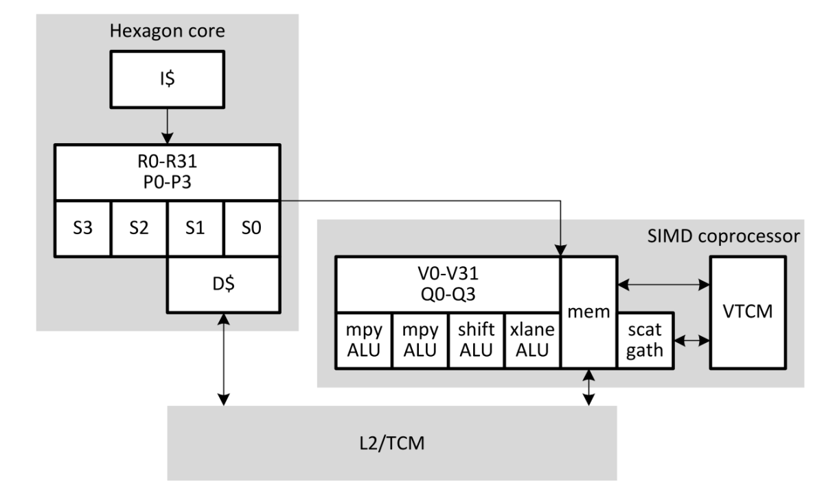
Opportunity#2: DSP efficiency in mixed-precision inference
Hexagon Digital Signal Processor (Hexagon DSP)
DSP is designed to allow significant compute workloads for advanced image processing and computer vision
DSP particularly suits integer operations, i.e., INT8-based matrix multiplication
DSP has been demonstrated to be 11.3×/4.0× more energy-efficient than CPU/GPU in DL inference tasks
Hexagon DSP Architecture
Inference energy results on TFLite (mAh)
 | CPU FP32 | CPU INT8 | DSP INT8
MobileNet-V1-224 | 0.00494 | 0.00126 | 0.000317
MobileNet-V2-224 | 0.00356 | 0.00127 | 0.000336
ResNet-224 | 0.0332 | 0.0073 | 0.00161
Inception-V4-299 | 0.11 | 0.0222 | 0.0033
EfficientNet-V2-224 | 0.0104 | 0.00333 | 0.000693
1024bit vector operation
Notes:
Another opportunity is that modern mobile SoCs often consist of heterogeneous processors, among which Hexagon Digital Signal Processor (that is Hexagon DSP)is ubiquitously available and efficient in mixed-precision inference.
(click1)
It is designed to allow significant compute workloads for advanced image processing and computer vision and particularly suits integer operations, like INT8-based matrix multiplication.
(click2)
That is because DSP can process 1024-bit fixed-point data inside one HVX instruction.
(click3 and 4)
It has been demonstrated to be 11.3×/4.0× more energy-efficient than CPU/GPU in Deep Learning inference tasks.

Slide 8

Opportunity
Mixed-precision inference
Efficient !!!
offloading
Low power
Vector integer operation
DSP
Integer matrix multiplication workload
Can we offload the mixed-precision training workload to DSP?
offloading
Mixed-precision training
Notes:
(click1)
We have already witnessed the success of the mixed-precision inference with DSP offloading
(click2)
Since mixed-precision training shares the same feature with inference that most calculation workload is the INT8 matrix multiplication，
(click3)
Can we offload the mixed-precision training workload to DSP to reduce the cost of on-device training?

Slide 9
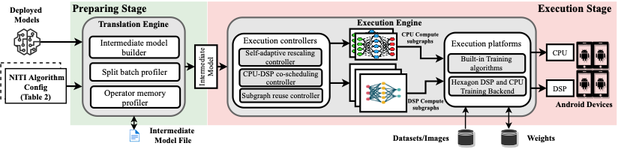




Design overview
Input mixed-precision training algorithms config, like NITI, and deployed model file
Generate CPU and DSP compute subgraphs
1⃣️
3⃣️
Translate models from different front-end frameworks
Perform compute subgraph
execution
2⃣️
4⃣️
Notes:
The answer is Mandheling， the first system that enables highly resource-efficient on-device training by orchestrating mixed-precision training algorithm with the on-chip DSP offloading.
(click1)
First, a user inputs his mixed-precision training algorithm config and the deployed model file.
(click2)
Then, in the preparing stage, Mandheling translates models from different front-end frameworks to intermediate models, including the operator type, hyperparameters, inputs, outputs and memory regions.
(click3)
Third, in the execution stage, Mandheling generates CPU and DSP compute subgraphs, via the CPU-DSP co-scheduling controller
(click4)
And, lastly, all subgraphs will execute on Android devices’ CPU or DSP via Mandheling’s Hexagon DSP and CPU Training backend.
To fully utilize the DSP, Mandheling incorporates four key techniques to solve the four challenges.

Slide 10
Challenge#1: DSP-unfriendly operators
Operator | CPU | DSP
Transpose | 3 ms | 25 ms
WeightRotate | 4 ms | 20 ms
Slice | 4 ms | 17 ms
Normalization | ✅Support | ❎ Not Support
Quantization
Round
Sqrt
Context
Switching
merge the adjacent DSP-unfriendly operators into subgraphs
DSP
CPU Subgraph1
Op1
Op2
Op4
DSP
Subgraph1
Op3
Op5
Op6
CPU Subgraph2
Op7
Op8
Op9
Op10
DSP
Subgraph2
DSP-unfriendly operators
Op11
Op12
Context switching overhead between DSP and CPU is unbearable,
e.g. 25ms on Xiaomi 10.
DSP-unfriendly operators can occur anywhere.
Notes:
The first challenge is DSP-unfriendly operators.
(click1)
Some irregular memory access or float operations are unsuitable for DSP to run, like transpose and normalization. We call such operators DSP-unfriendly operators.
(click2 and 3)
An intuitive approach is to merge the adjacent DSP-unfriendly operators into subgraphs and place them on the CPU.
(click4)
However, since CPU-DSP context switching incurs a high overhead, e.g. 25ms on Xiaomi 10, and such unfriendly operators can occur anywhere, this approach could lead to non-optimal performance.

Slide 11
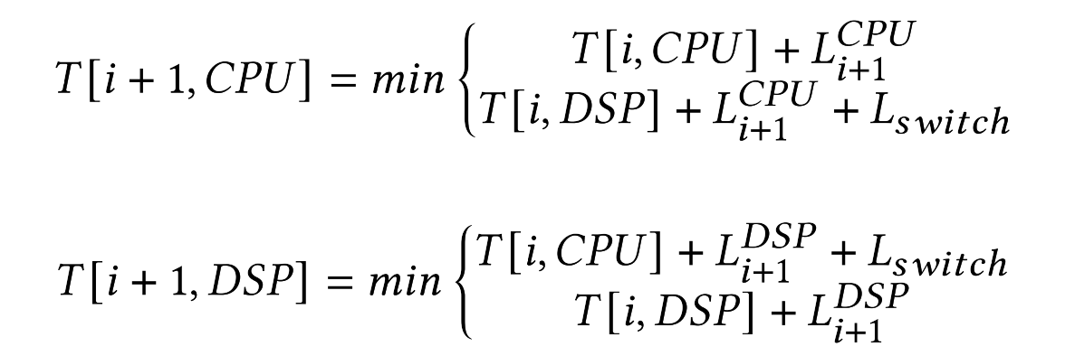
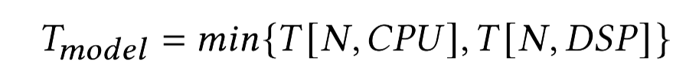
CPU-DSP co-scheduling
Insight#1: Reduce the context-switching overhead of DSP-unfriendly operators rather than to provide maximal CPU-DSP parallelism.
Topological sort: find an execution order for all operators
Dynamic programming algorithm: determine the operator placement
Recursion formula
Objective function
Notes:
Therefore, we propose a context-switching-aware CPU-DSP co-scheduling strategy.
The insight is to reduce the context-switching overhead of DSP-unfriendly operators rather than to provide maximal CPU-DSP parallelism,
since allocating more computations to CPUs and parallelizing them with DSP can only potentially bring a modest improvement in speed but with huge energy consumption.
(click1)
Mandheling first uses topological sort to get an execution order for all operators and profiles to obtain each operator’s latency on CPU and DSP.
(click2)
Then, we use a dynamic programming algorithm to find the approximately optimal scheduling solution while obeying the execution order.
(click3 and 4)
𝑇 [𝑖 + 1,𝐶𝑃𝑈 ] is the lowest latency of finishing from 𝑂𝑝1 to 𝑂𝑝𝑖+1 if 𝑂𝑝𝑖+1 is running on CPU.
When both 𝑂𝑝𝑖+1 and𝑂𝑝𝑖 are running on CPU, there is no context switching. Otherwise, a context-switching overhead is added.
(click5 and 6)
The objective function can be formulated as the minimum value of 𝑇 [𝑁 ,𝐶𝑃𝑈 ] and 𝑇 [𝑁 , 𝐷𝑆𝑃]

Slide 12
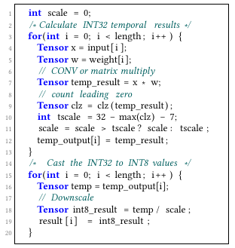
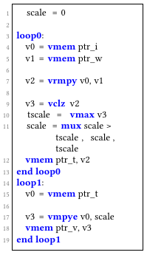
Challenge#2: dynamic rescaling does not fit DSP
Dynamic rescaling
The scale factor needs to be dynamically adapted.
☹
Downscaling the temporal outputs to final INT8 results needs to store the temporal outputs and reload them.
☹
Add at least 2x latency compared with static rescaling
Notes:
The second challenge is dynamic rescaling does not fit DSP.
(click1 and 2)
The scale factor needs to be dynamically adapted.
(click3 and 4)
Downscaling the temporal outputs to final INT8 results needs to store the temporal outputs and reload them.
(click5)
These two operations add at least 2x latency compared with static rescaling.

Slide 13
Self-adaptive rescaling
Insight#2
The scale factor jumps between two alternative values.
The actual changing frequency of the scale factor is low, e.g., per 10–60 batches.
Self-adaptive rescaling: Periodically enable rescaling, instead of per batch
Notes:
To solve this problem,
(click1 and 2)
We find that the scale factor jumps between two alternative values.
And the actual changing frequency of the scale factor is low, e.g., per 10–60 batches
(click3)
So we propose self-adaptive rescaling: Periodically enable rescaling, instead of per batch.

Slide 14
Challenge#3: exhausted data cache
Input size | Latencies of different batch sizes (ms)
 | 2 | 4 | 8 | 16 | 32 | 64
8 x 8 | 0.63 | 0.63 | 0.85 | 1.03 | 1.27 | 1.84
16 x 16 | 0.84 | 0.89 | 4.23 | 3.98 | 4.64 | 12.24
32 x 32 | 1.69 | 2.50 | 59.11 | 62.35 | 68.14 | 152.89
Training tasks often require a large batch size
The DSP cache is often smaller than the CPU cache
8× theoretical workload
27.3×latemcy
Notes:
The third challenge is the exhausted data cache.
We observe a huge performance decline for the large operator and batch sizes, especially for weight-gradient calculation.
(click1)
That is because Training tasks often require a large batch size.
(click2)
and the DSP cache is often smaller than the CPU cache.

Slide 15
Batch splitting
Input size | Latencies of different batch sizes (ms)
 | 2 | 4 | 8 | 16 | 32 | 64
8 x 8 | 0.63 | 0.63 | 0.85 | 1.03 | 1.27 | 1.84
16 x 16 | 0.84 | 0.89 | 4.23 | 3.98 | 4.64 | 12.24
32 x 32 | 1.69 | 2.50 | 59.11 | 62.35 | 68.14 | 152.89
Training tasks often require a large batch size
The DSP cache is often smaller than the CPU cache
Abnormally
batch
Micro-batch
Scaling factor1
rescaling
output
MAX: factor1 and factor2
Scaling factor2
Micro-batch
Notes:
(click1)
We call such a phenomenon that Operators behave “abnormally”.
We use the latency-to-workload ratio to find that phenomenon.
If the ratio is noticeably higher than the same configuration but with smaller batch size, the phenomenon occurs.
(click1)
We propose batch splitting to solve this problem.
And Mandheling will split an abnormal batch into multiple micro-batches and executes them individually.

Slide 16
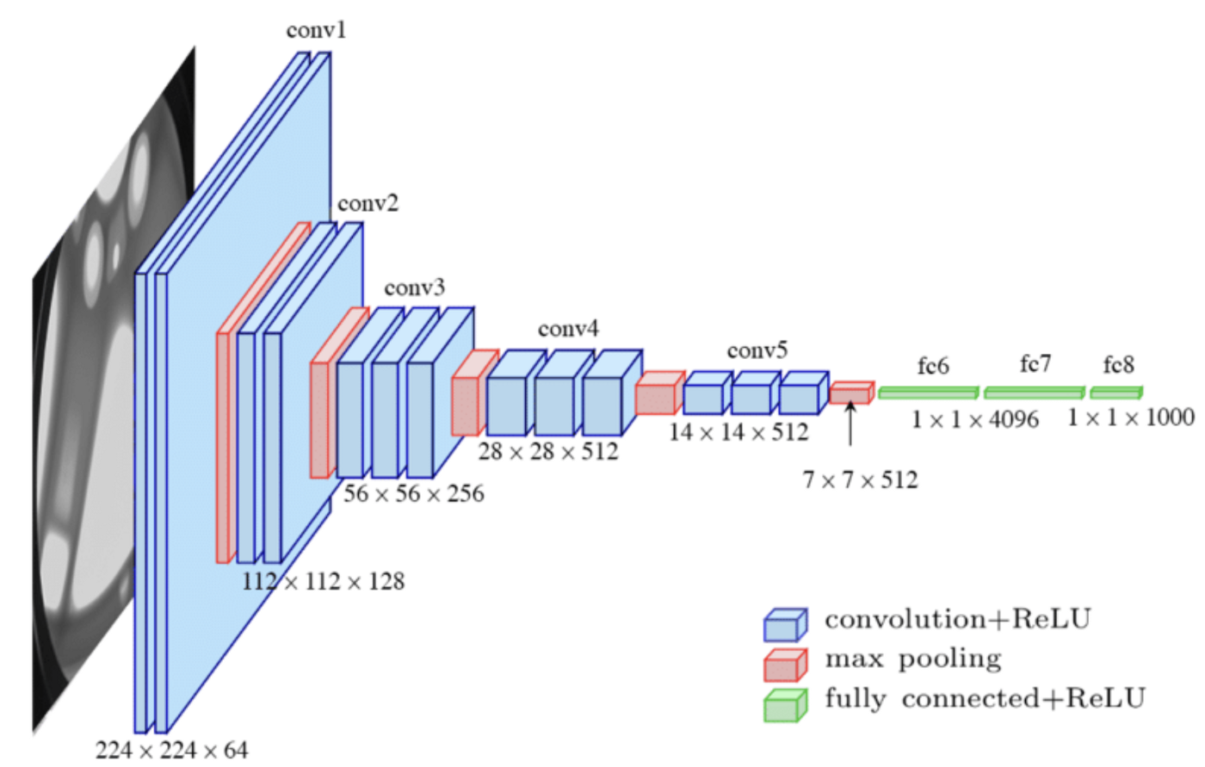
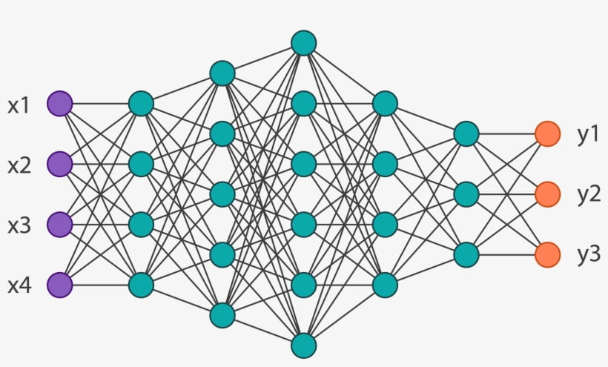
Challenge#4: costly compute-subgraph preparation
VGG16 Model
Establish operator’s inputs and outputs list
Establish a new graph node
Establish const attribute nodes, like kernel size and stride
DSP
Establish one operator node
Allocate memory for inputs and outputs
Transform data layouts, e.g. plain to d32
Hexagon DSP
compute subgraph
Optimize the compute graph, like operator fusion
Build the whole compute subgraph
304ms on TFLite and 212ms on MNN for the VGG16 model
Notes:
The last challenge is the costly compute-graph preparation.
(click1)
Mandheling should first establish each operator node, including the operator’s inputs, outputs, new graph node and const attribute nodes.
(click2)
When building the whole compute graph, mandheling should allocate memory for inputs and outputs, transform data layouts and optimize the compute graph.
(click3)
And finally, the hexagon DSP compute graph can execute on the DSP.
(click4)
Such processure takes a considerable amount of time, e.g., 304ms on TFLite and 212ms on MNN for the VGG16 model.

Slide 17
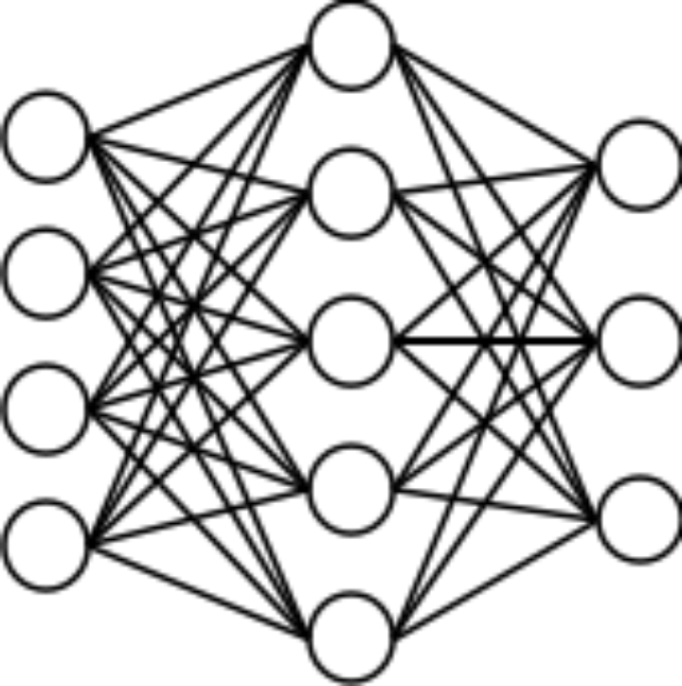
DSP compute subgraph reuse
Insight#4: the models are rarely modified during on-device training
Memory
Budget
4GB
Preparing stage: Mandheling profiles all memory regions used by compute subgraphs.
Execution stage: Mandheling releases the MRU memory regions and allocates space for new subgraphs
1GB
1GB
2GB
3GB
Memory budget limits the number of DSP compute graph
Notes:
To tackle this challenge, mandheling resue the DSP compute subgragh, since the models are rarely modified after deploying on the device.
(click1)
However, the DSP memory budget limits the number of DSP compute subgraphs reused.
(click2)
To solve this problem, in the preparing stage, Mandheling profiles all memory regions used by compute subgraphs.
In the execution stage, Mandheling releases the MRU memory regions and allocates space for new subgraphs if exceeding the memory budget.

Slide 18
Evaluation: settings
Devices and models
Baselines
TFLite-FP32: TFLite FP32-based training method
MNN-FP32: MNN FP32-based training method
MNN-INT8: the INT8-based training method implemented by us based on MNN (NEON is extensively used
to optimize the performance of this baseline)
MNN-FP32-GPU: FP32-based training on mobile GPU through the OpenCL backend
Model | Dataset | FLOPS | # of CONVs
VGG-11 | CIFAR-10 | 914M | 8
VGG-16 | CIFAR-10 | 1.35G | 13
VGG-19 | ImageNet | 26.92G | 16
ResNet-34 | CIFAR-10 | 7.26G | 36
ResNet-18 | ImageNet | 11.66G | 20
InceptionV3 | CIFAR-10 | 2.43G | 16
Device | SoC | Memory
Xiaomi 11 Pro | SnapDragon 888 | 12GB
Xiaomi 10 | SnapDragon 865 | 8GB
Redmi Note9 Pro | SnapDragon 750G | 8GB
Notes:
We implemented Mandheling with 15k LoC in C/C++ and 800 LoC of assembly language in total.
We use 3 different devices and 6 models to evaluate its performance.
We use 4 baselines for fair comparison.
(click1)
The standard TFLite-FP32 and MNN-FP32 training method.
MNN-INT8: the INT8-based training method implemented by us based on MNN (NEON is extensively used to optimize the performance of this baseline)
MNN-FP32-GPU: FP32-based training on mobile GPU through the OpenCL backend

Slide 19
Evaluation: per-batch performance
Mandheling v.s. FP32 training
Reduce per-batch training time by up to 8.5×.
Reduce per-batch training energy consumption by up to 11.2×.
Notes:
For per-batch performance, compared with the FP32 baselines, the Experiment result shows mandheling can reduce per-batch training time and energy consumption by up to 8.5× and 11.2×, respectively.
Such a huge benefit comes from both the training speedup and the higher power efficiency of DSP

Slide 20
Evaluation: per-batch performance
Mandheling v.s. GPU
Reduce per-batch training time by 3.98-11.63×.
Reduce per-batch training energy consumption by 3.46-10.95×.
Notes:
Mandheling can reduce latency 3.98-11.63× and energy consumption 3.46-10.95× compared with MNN-FP32-GPU.
The reason for such a huge improvement is that
(1) as far as we know, MNN is the only framework supporting on device GPU training and is not fully optimized yet (GPU utilization during training is only around 30-50%);
(2) DSP is more power efficient than GPU.

Slide 21
Evaluation: per-batch performance
Mandheling v.s. MNN INT8
Reduce per-batch training time by up to 4.13×.
Reduce per-batch training energy consumption by up to 6.5×.
Notes:
Mandheling can reduce latency by up to 4.13× and energy consumption by 6.5× compared to MNN-INT8, respectively.
the improvements come from Mandheling’s ability to fully utilize the DSP hardware.

Slide 22
Evaluation: end-to-end performance
Training on device takes 3.55× less time
Cross-device federated learning achieves a 5.26× and 10.75× speedup
VGG11-CIFAR10-Local
ResNet18-CIFAR10-Local
LENET-FEMNIST-Federated
VGG16-CIFAR100-Federated
Notes:
For end-to-end performance,
(click1 and 2)
Training on the device locally takes 3.55× less time
(click3 and 4)
Cross-device federated learning achieves a 5.26× and 10.75× speedup.

Slide 23
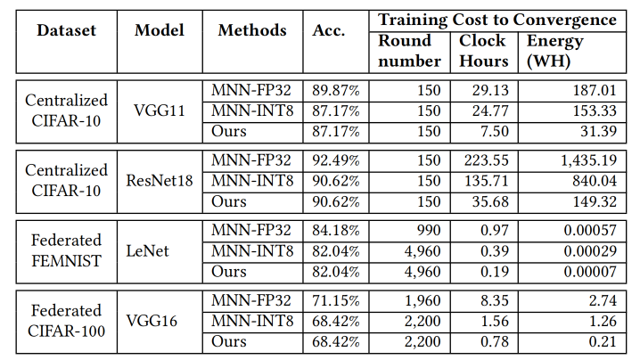
Evaluation: end-to-end performance
Reduce the energy consumption of a single client by 5.16-13.1×
Only 1.9%-2.7% loss compared to the accuracy of the FP32 precision setting
Notes:
(click1 and 2)
Besides, mandheling can Reduce the energy consumption of a single client by 5.16-13.1×
(click3 and 4)
With only a 1.9%-2.7% convergence accuracy loss compared with the FP32 precision setting.
Those benefits all come from the four practical designs incorporated by mandheling.

Slide 24
Evaluation: fit to various training algorithms
The training speeds of three mixed-precision algorithms are all faster than that of MNN-FP32 (3.08×, 2.34×, and 7.1× speedup)
Mandheling’s energy consumption improvement is more significant, i.e., 3.64× and 6.85× average reduction for VGG11 and VGG16, respectively.
Mandheling’s performance using different mixed-precision training algorithms.

Slide 25

Conclusion
The first on-device training system that enables mixed-precision training with on-chip DSP offloading
Support many DSP-friendly operators
Open source: https://github.com/UbiquitousLearning/Mandheling-DSP-Training
Notes:
(click1)
In conclusion, we propose mandheling, an efficient on-device learning framework that enables highly resource-efficient on-device training by orchestrating mixed-precision training with on-chip DSP offloading.
(click2)
We implement a prototype of mandheling and support many DSP-friendly operators.
(click3)
mandheling has been open-sourced, all of the source code can be found here.

Slide 26

Mandheling: Mixed-Precision On-Device DNN Training with DSP Offloading
On-device
Training
DSP
offloading
Mixed-
precision
Code: https://github.com/UbiquitousLearning/Mandheling-DSP-Training
xudaliang@pku.edu.cn
https://daliangxu.github.io/
More about our affordable AI systems: http://www.liuxuanzhe.com
Notes:
Thanks for your listening.
If you have any questions about mandheling, please ask Daliang Xu via this e-mail address.
If you are interested in our affordable AI systems, please refer to this web site for more details.

